Slide 1
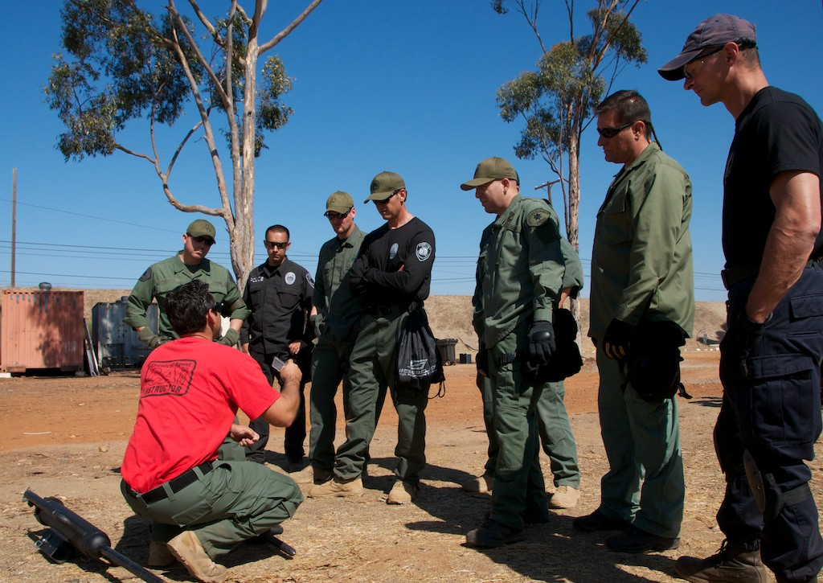

Liability Aspects:
Using Chemical Agents in a Modern Tactical Environment!

Slide 2
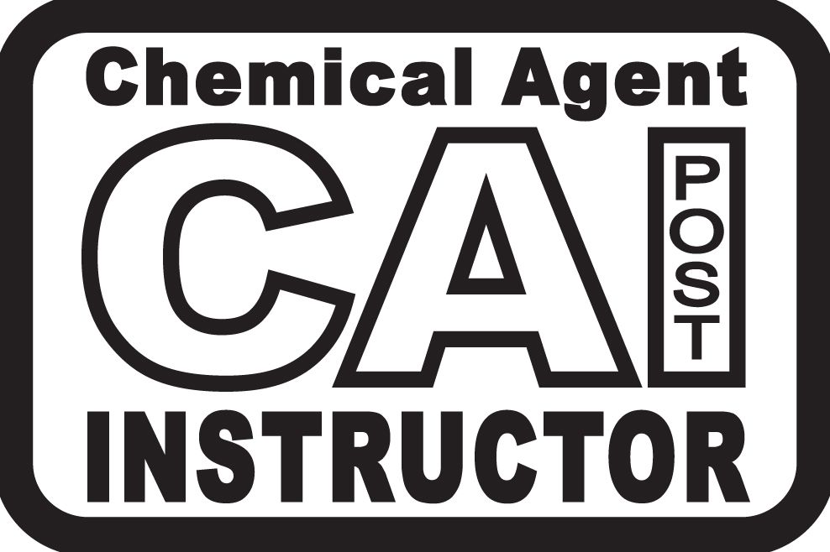
Breakout Group Exercise:
As a CAI Team:
What is the biggest Liability Issue on your Team?
As a new CAI, how are you going to fix it?
1 Minute Brief

Slide 3
Liability:
First, a few questions…..
  Why do we use Chemical Agents?
  Are there risks to deploying Chemical Agents?
  Can/Has Chemical Agents killed people?
  Does your knowledge as an Instructor affect Liability?
  Does you and your SWAT Team’s knowledge of Chemical Agents affect Liability?

Slide 4
Liability:
What can get us in Trouble
  The quantity of Chemical Agents used
    Can we use too much Chemical Agents?
    What’s your team’s philosophy on the amount of gas used?
    Understanding “Reasonable” as it relates to deploying Chemical Agents!

Slide 5
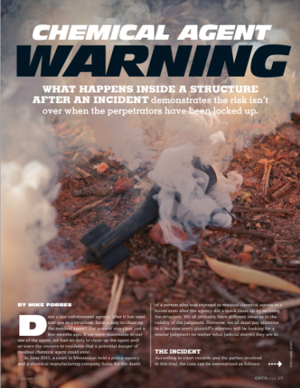
Liability:
What can get us in Trouble
  Not Decontaminating Structures
    Do we have a responsibility (City, County, Team) to “Decon” a structure?
    Reasonableness in our Approach! Going the extra effort…
    Warning Notices (samples)
    “We decon today, so we can gas tomorrow”

Slide 6
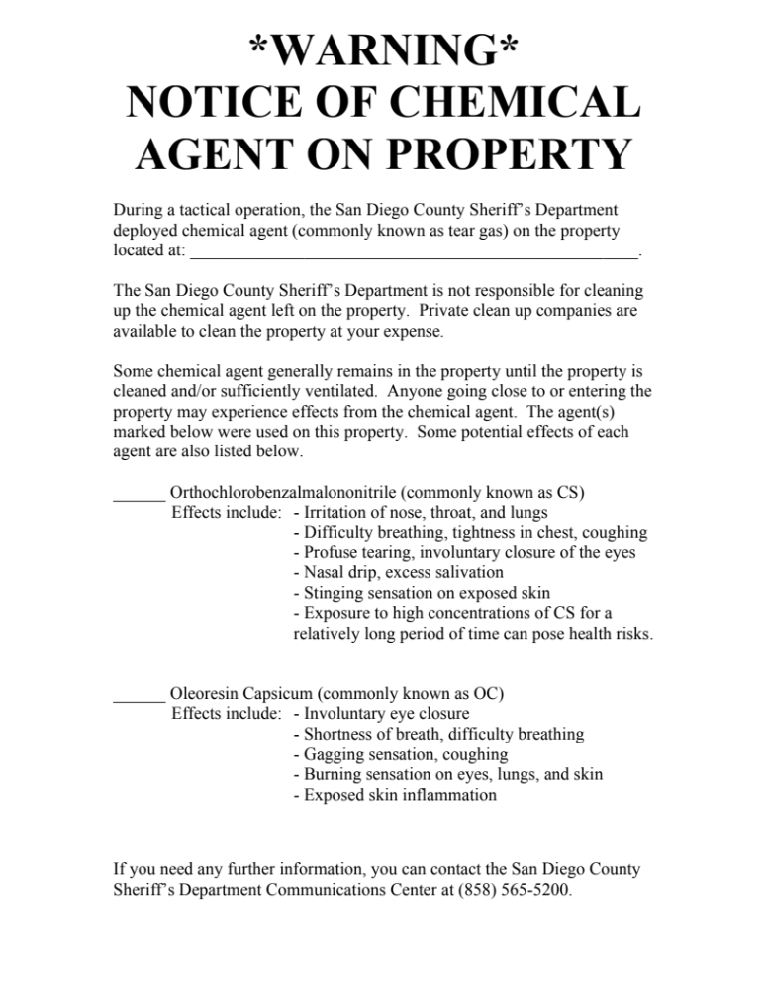
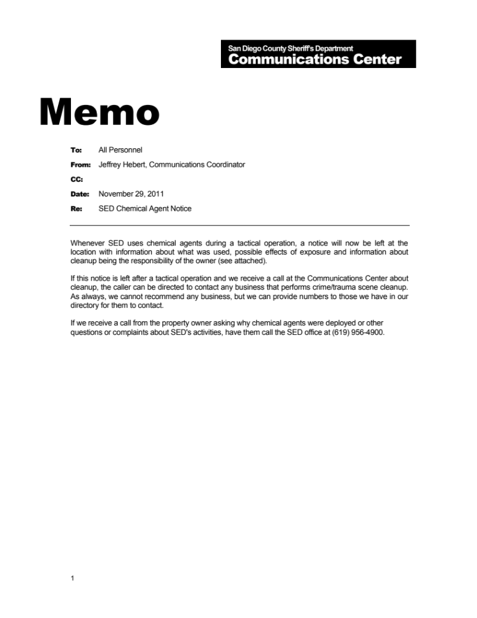

Slide 7
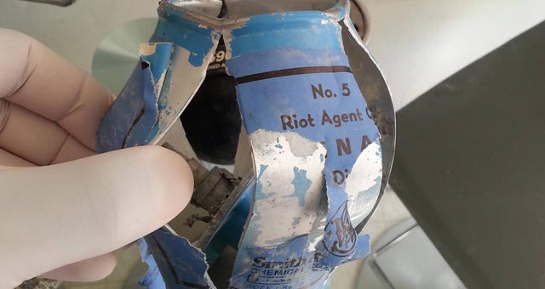
Liability:
What can get us in Trouble
  Not Collecting Evidence
    Gather all expended Munitions (Tactical / MMF)
    Photograph and Video
    Book as Evidence when possible (expended chemical agents might not be able to be booked)

Slide 8
Liability:
What can get us in Trouble
  Quality and Type of Training
    Will your training be called into question?
    How do you limit your liability exposure?
      Training that reflects your mission?
      Operator Proficiency
        Launchers
        APR’s
        In live Agent
      Fit Testing
      Validate through your own human testing!
      Documentation of Training - Lesson Plans, Rosters, etc.

Slide 9
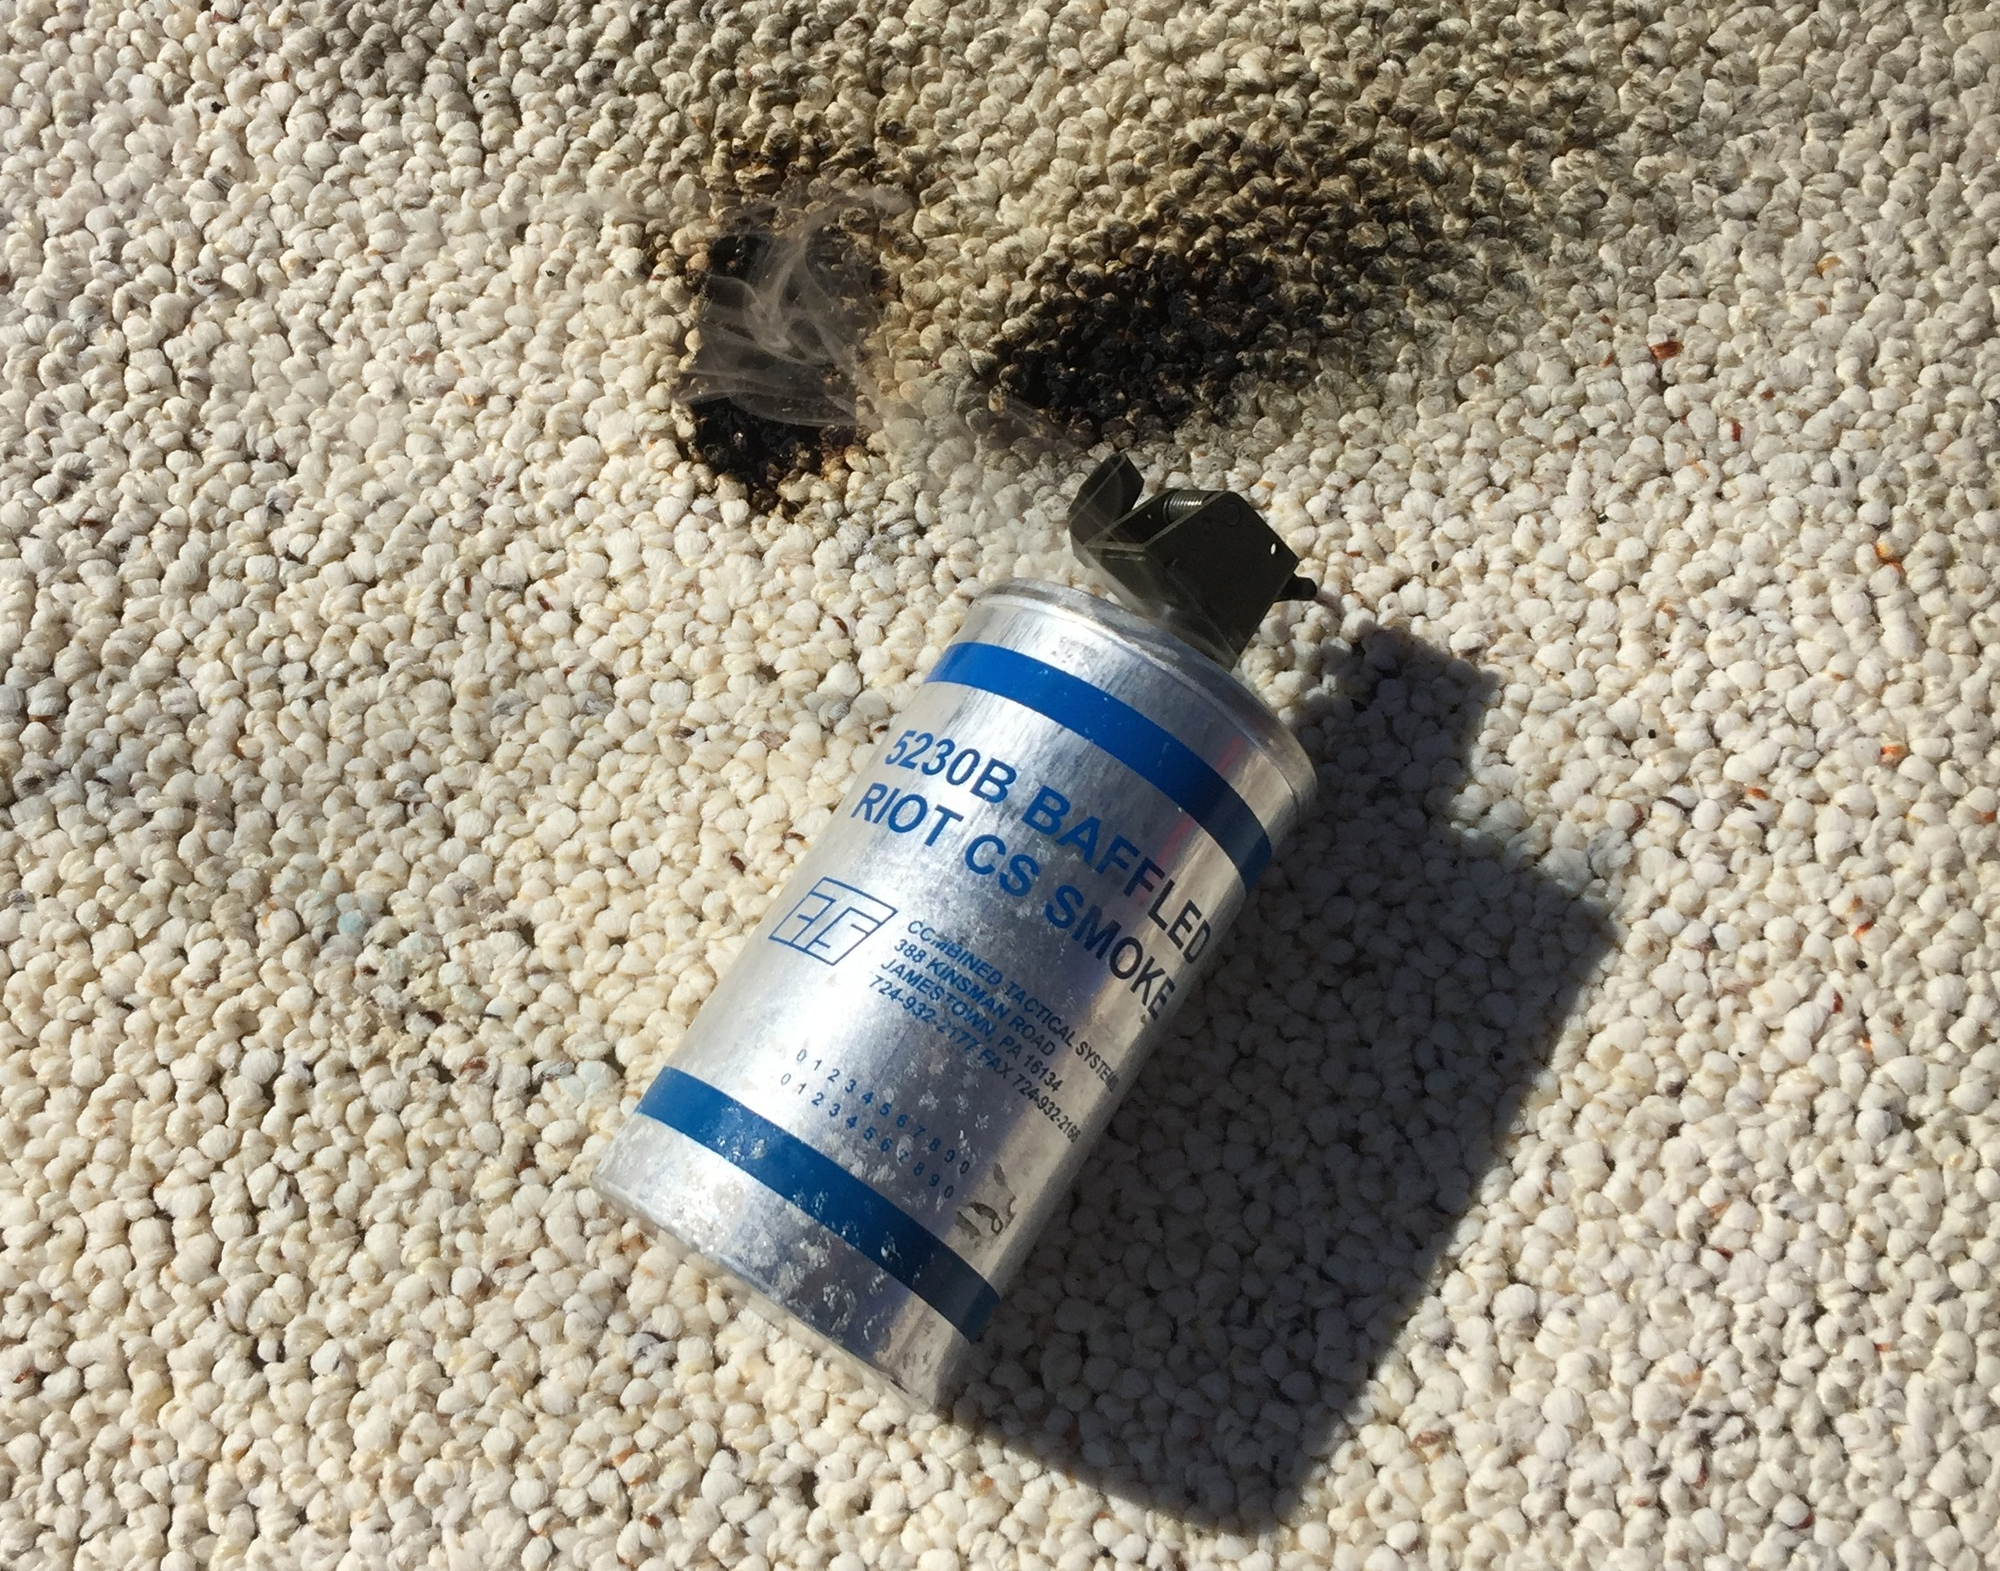
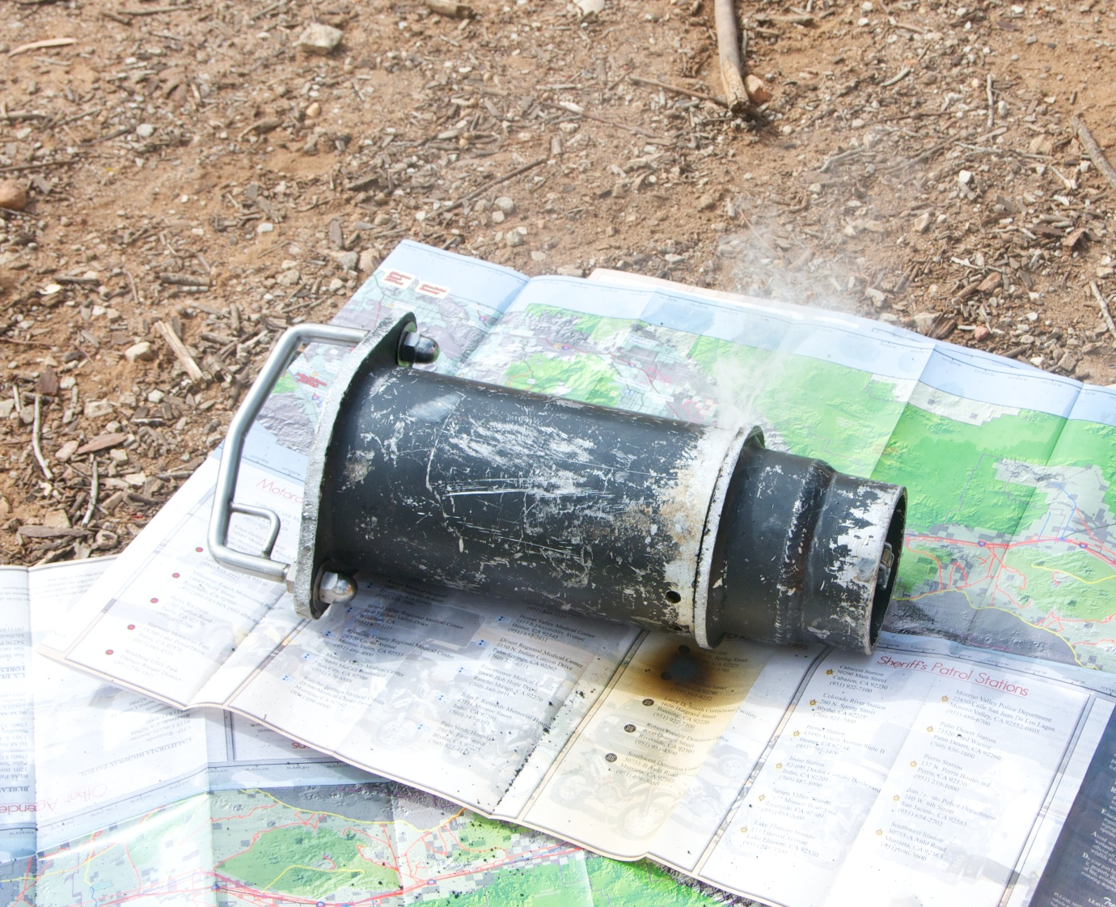
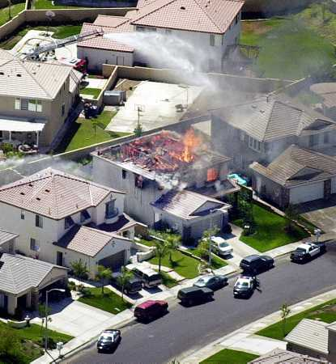
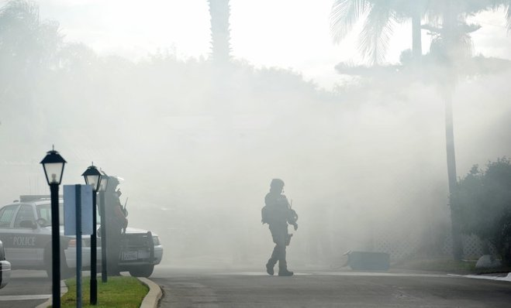
Liability:
What can get us in Trouble
  Burning Structures Down
    All Aspects of your Chemical Agents Program will be scrutinized?
    How do we explain/justify burning a structure down?
    How do we avoid burning a structure down?
      Burnsafe/Gas Ram type devices
      Baffled Grenade type devices
      Non-pyro munitions
      Knowing our Business!

Slide 10
Liability:
What can get us in Trouble
  Not Knowing our Business
    As Instructors, what responsibility do we have to ourselves, our team, our organization?
    The tactical use of Chemical Agents is both science and art!
    This discipline requires considerable “self study”. The amount of “self study” directly correlates to your programs success.
    Society demands we Know our Business!

Slide 11
Liability:
A few last thoughts:
  Looks Matter
  What’s the back up plan if suspect(s) don’t exit after deploying Chemical Agents?
  Is your plan reasonable and legally defensible?
  Does your plan “Make Sense!”
  What are other teams in your region doing?

Slide 12
Questions
or
Comments

Slide 13
Breakout Group Exercise:
As a CAI Team:
What is the biggest Liability Issue on your Team?
As a new CAI, how are you going to fix it?
1 Minute Brief

